Slide 1

VLSI Design Project
8-bit ALU & 16-bit Single-Cycle RISC Processor
with 2-Stage IF/ID Pipeline
Submitted by
Mythri Peddamariveedu
B.Tech — Electronics and Communication Engineering

Slide 2
Contents
1. Abstract
2. Introduction / Background
3. Objective of the Study
4. Problem Definition
5. Scope of the Study
6. Literature Review
7. Methodology / Approach
8. Experimental Setup
9. Analysis and Interpretation
10. Results / Findings
11. Consolidation Table
12. Discussion
13. Proposed System
14. Feasibility Study
15. Design / Workflow
16. Architecture Diagram
17. Methods & Techniques
18. Progress in Project
19. Outcome / Results
20. Conclusion
21. References
TechGlobal VLSI Internship — Project Presentation
2

Slide 3
Abstract
Designed and verified a 16-bit Single-Cycle RISC Processor using Verilog HDL.
Implemented modular RTL components including the Program Counter, Instruction Memory, Register File, ALU, Control Unit, Data Memory, and IF/ID Pipeline Register.
Executed arithmetic, logical, and memory operations through a simplified RISC architecture.
Performed functional verification using a dedicated testbench and analyzed simulation waveforms in Xilinx Vivado.
Successfully completed synthesis and implementation, validating the processor design and timing performance.
Developed a scalable processor architecture that can be extended for future FPGA implementation and advanced pipeline stages.
TechGlobal VLSI Internship — Project Presentation
3

Slide 4
Introduction / Background
VLSI (Very Large Scale Integration) design underpins nearly every modern electronic system, from consumer devices to data-center processors.
Verilog HDL is the industry-standard hardware description language used to specify digital circuit behavior at the Register-Transfer Level (RTL).
The Arithmetic Logic Unit (ALU) is the computational core of any processor — understanding it is foundational to processor design.
A RISC (Reduced Instruction Set Computer) processor integrates an ALU with a datapath, control logic, and memory into a working programmable system.
This project bridges classroom digital-logic theory with practical, tool-based RTL design using Xilinx Vivado.
TechGlobal VLSI Internship — Project Presentation
4

Slide 5
Objective of the Study
1
Practical RTL Skill-Building
4
Professional Practice
Gain hands-on experience in Verilog HDL beyond classroom theory.
Apply modular coding, systematic verification, and version control.
2
Full Design Flow Exposure
5
Reusable Design
Learn specification, coding, simulation, synthesis, and implementation using industry EDA tools.
Carry a verified ALU core forward into a larger processor system.
3
Progressive Complexity
6
Documentation Discipline
Advance from a combinational ALU to a complete pipelined processor.
Produce industry-style technical documentation for every deliverable.
TechGlobal VLSI Internship — Project Presentation
5

Slide 6
Problem Definition
Digital systems require verified, efficient hardware building blocks. There is a need to design a compact, correctly-functioning 8-bit ALU covering arithmetic, logical, and shift operations — and to demonstrate how such a unit integrates into a complete, working processor capable of fetching, decoding, and executing a defined instruction set, while remaining resource-efficient and timing-clean when synthesized to real hardware.
Core question: can a modular, independently-verified ALU be scaled and reused as the execution core of a larger, pipelined processor without re-engineering it from scratch?
TechGlobal VLSI Internship — Project Presentation
6

Slide 7
Scope of the Study
In Scope
Out of Scope
8-bit ALU: ADD, SUB, AND, OR, XOR, NOT, SHL, SHR
16-bit RISC processor with 16 registers, 256-word memory
2-stage IF/ID pipeline
Functional simulation, synthesis, timing/utilization/power analysis
Hazard detection and data forwarding
Branch / jump instructions
Multi-stage (5-stage) pipelining
Cache memory and interrupt handling
Physical FPGA hardware bring-up
TechGlobal VLSI Internship — Project Presentation
7

Slide 8
Literature Review
Source | Relevance
Panigrahi et al., IEEE 2019 — 4-bit ALU on BASYS3 FPGA | Vivado-based ALU synthesis methodology on the same FPGA family used here
Jeemon, IEEE RTEICT 2016 — Pipelined 8-bit RISC Processor | Directly comparable 8-bit pipelined RISC design in Verilog HDL
IEEE Xplore Doc. 10169818 — 5-Stage Pipelined RISC Processor (16-bit) | 16-bit instruction width pipeline design, matching this project's data width
IEEE Xplore Doc. 10544184 — Pipelined RISC-V on Basys-3 | Single-cycle vs. pipelined timing (WNS) comparison methodology reused here
Patterson & Hennessy, Computer Organization and Design (RISC-V Ed.) | Foundational RISC datapath and pipeline theory
IEEE Std 1364-2005 (Verilog HDL) | Language semantics and coding standards
TechGlobal VLSI Internship — Project Presentation
8

Slide 9
Methodology / Approach
1
2
3
4
5
Specify
Implement
Verify
Synthesize
Analyze
▶
▶
▶
▶
Define opcode table, instruction format, and module I/O before writing any code
Code each operation / datapath block as an independent Verilog module
Unit-test each module, then integrate and self-check at the top level
Run synthesis and implementation in Xilinx Vivado
Review timing, utilization, and power reports
Consistent with standard RISC design practice: single-cycle baseline verified first, pipeline added as an enhancement afterward.
TechGlobal VLSI Internship — Project Presentation
9

Slide 10
Experimental Setup
Tools & Platform
Data Collection Method
Verilog HDL — RTL design language
Xilinx Vivado 2019.1 — synthesis & implementation
XSim — behavioral simulation
Git & GitHub — version control
Hand-calculated expected values per test vector
Self-checking testbenches comparing actual vs. expected output
Waveform capture (.vcd) for visual verification
Post-implementation reports: timing, utilization, power
TechGlobal VLSI Internship — Project Presentation
10

Slide 11
Analysis and Interpretation
Pipeline latency: each instruction completes 2 clock cycles after fetch due to the IF/ID register — confirmed by tracing write-back timing in simulation.
Throughput: despite 2-cycle latency, steady-state throughput remains 1 instruction/cycle once the pipeline is full.
Timing: zero failing endpoints on the ALU's combinational paths — expected, since no clock constraints apply to purely combinational logic.
Resource usage: the subtractor consumed more LUTs than the adder (21 vs. 4), reflecting the extra carry/borrow logic two's-complement subtraction requires.
TechGlobal VLSI Internship — Project Presentation
11

Slide 12
Results / Findings
80/80
6/6
54
0
ALU test vectors passed
RISC processor checks passed
LUTs used (ALU synthesis)
Timing violations
All 8 ALU operations verified across 10 vectors each, including carry/borrow and zero-flag edge cases.
RISC processor correctly executed LOAD, ADD, STORE, and AND instructions with matching register and memory outputs.
Zero flag correctly asserted when the AND operation produced an all-zero result.
TechGlobal VLSI Internship — Project Presentation
12

Slide 13
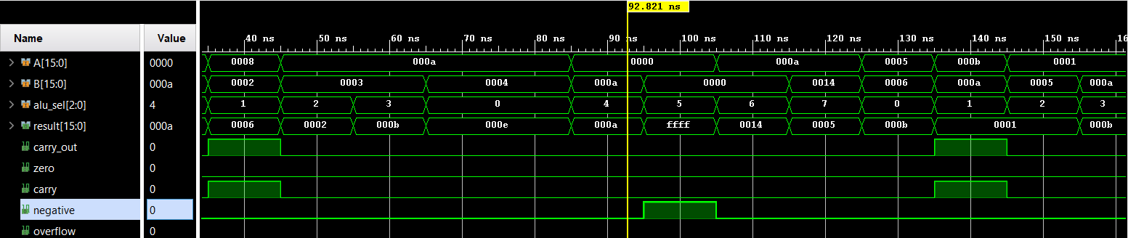
Simulation Waveform Evidence
[ Insert RISC Processor Waveform Screenshot Here ]
Project 1 — 8-bit ALU: representative waveform, all 8 operations
TechGlobal VLSI Internship — Project Presentation
12b

Slide 14
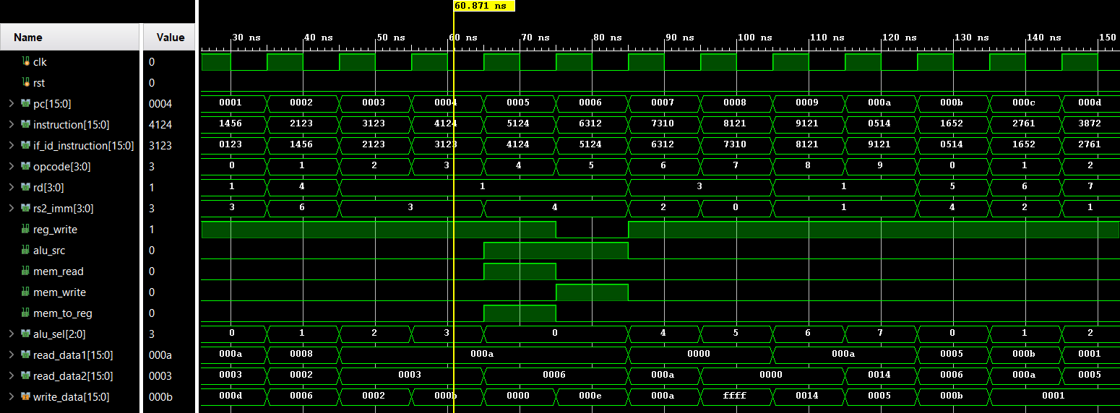
Project 2.1: Processor Waveform Output

Slide 15
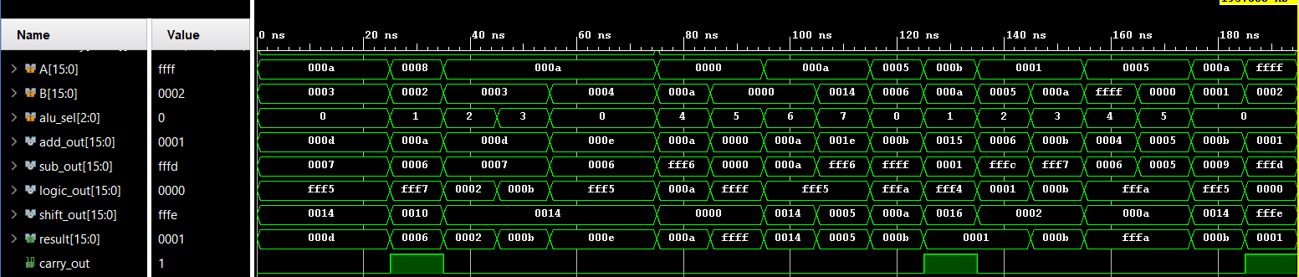
Project 2.2 : Processor ALU Waveform

Slide 16
ISA OPCODE SUMMARY
Consolidation Table
Opcode | Mnemonic | Type | Operation | ALU Sel
0000 | ADD | R-type | Rd = Rs1 + Rs2 | 000
0001 | SUB | R-type | Rd = Rs1 - Rs2 | 001
0010 | AND | R-type | Rd = Rs1 & Rs2 | 010
0011 | OR | R-type | Rd = Rs1 | Rs2 | 011
0100 | LOAD | I-type | Rd = Mem[Rs1 + imm] | 000
0101 | STORE | I-type | Mem[Rs1 + imm] = Rs2 | 000
0110 | XOR | R-type | Rd = Rs1 ^ Rs2 | 100
0111 | NOT | R-type | Rd = ~Rs1 | 101
1000 | SHL | R-type | Rd = Rs1 << 1 | 110
1001 | SHR | R-type | Rd = Rs1 >> 1 | 111
TechGlobal VLSI Internship — Project Presentation
13

Slide 17
Discussion
Leveraged the knowledge gained from the 8-bit ALU project to accelerate the design and integration of the 16-bit RISC processor, ensuring consistency in arithmetic and logical operations.
Adopted a modular RTL design approach, which simplified the development, integration, verification, and debugging of individual processor components.
Successfully verified processor functionality using a self-checking Verilog testbench, validating instruction execution, ALU operations, register updates, and memory access through simulation.
Completed the complete RTL design flow, including coding, simulation, synthesis, implementation, and timing analysis using Xilinx Vivado.
The implemented architecture provides a strong foundation for future enhancements such as additional pipeline stages, hazard handling, expanded instruction support, and FPGA deployment.
TechGlobal VLSI Internship — Project Presentation
14

Slide 18
Proposed System
A 16-bit Single-Cycle RISC Processor with a 2-stage IF/ID pipeline — proposed and implemented as an enhancement beyond the baseline single-cycle requirement, directly reusing the verified 8-bit ALU as its Execute-stage core.
Program
Counter
Instruction
Memory
IF/ID
Register
Control
Unit +
Register File
16-bit
ALU
Data
Memory
Write
Back
▶
▶
▶
▶
▶
▶
Proposed system reuses Project 1's verified ALU core (highlighted) as the Execute stage of Project 2.
TechGlobal VLSI Internship — Project Presentation
15

Slide 19
Feasibility Study
1
Resource Feasibility
ALU uses only 54 Slice LUTs (0.68% of an 8000-LUT device) — well within budget for integration into a larger system.
2
Timing Feasibility
Zero failing timing endpoints across all paths analyzed; no setup/hold violations reported.
3
Power Feasibility
On-chip power dominated by I/O (expected for a small design); logic power remains minimal, confirming an efficient implementation.
Conclusion: The design is technically feasible for synthesis and implementation on a real FPGA target.
TechGlobal VLSI Internship — Project Presentation
16

Slide 20
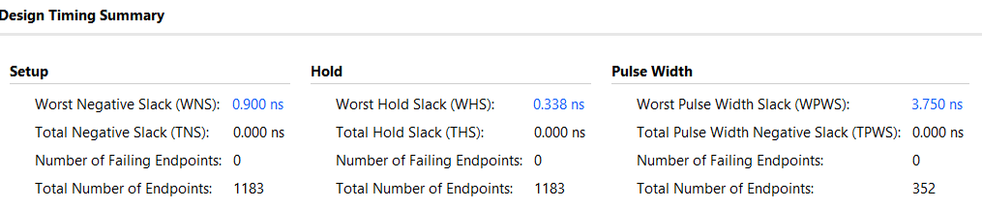
POST-SYNTHESIS EVIDENCE — Major Project
Implementation Reports
Timing Summary
TechGlobal VLSI Internship — Project Presentation
16b

Slide 21
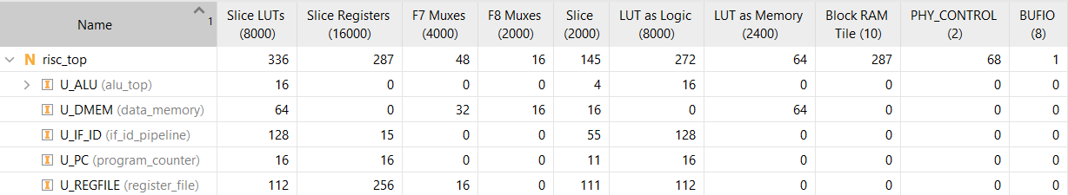
Resource Utilization report

Slide 22
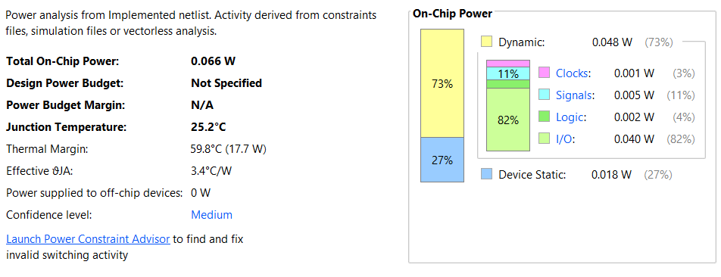
Power Analysis

Slide 23
Design Workflow
Spec &
ISA Design
Module-Level
RTL Coding
Unit
Simulation
Top-Level
Integration
Self-Checking
Verification
Synthesis &
Implementation
▶
▶
▶
▶
▶
Each stage gated the next: no module moved to integration until it passed unit-level simulation.
Single-cycle processor was fully verified before the IF/ID pipeline register was introduced, isolating functional bugs from pipeline-timing bugs.
TechGlobal VLSI Internship — Project Presentation
17

Slide 24
Architecture Diagram
FETCH
▶
DECODE
▶
EXECUTE
▶
MEMORY
▶
WRITE
BACK
PC update,
Instruction
Memory read
IF/ID reg,
Control Unit,
Register read
16-bit ALU
(reused from
Project 1)
Data Memory
read / write
Result to
Register File
IF/ID Pipeline boundary: Fetch stage separated from Decode-through-Write-back
TechGlobal VLSI Internship — Project Presentation
18

Slide 25
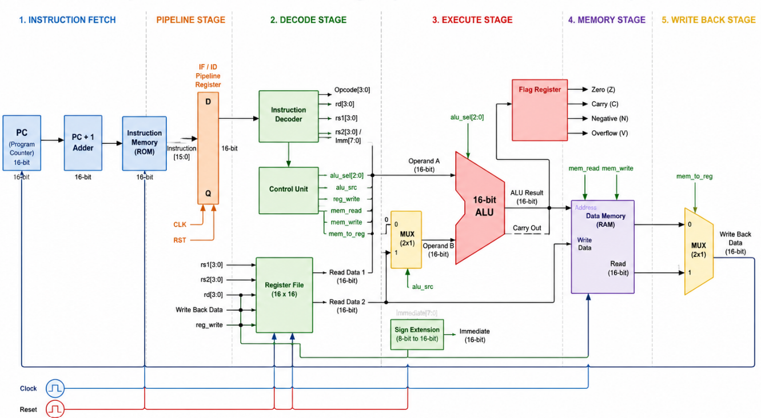

Slide 26
Methods and Techniques Used
Modular RTL design — each operation / datapath block coded and tested as an independent module before integration.
Self-checking testbenches — automated PASS/FAIL comparison against hand-calculated expected values, rather than manual waveform inspection alone.
Golden-model cross-checking — plain Verilog operators used as an independent reference to catch structural integration bugs.
Hierarchical debug ports — top-level signals (pc_out, write_back_out, zero_out, etc.) exposed for both simulation and future FPGA-level observability.
Version-controlled iterative development — structured Git commit history documenting each design and verification milestone.
TechGlobal VLSI Internship — Project Presentation
19

Slide 27
Progress in Project
MONTH 1
Classroom training — Verilog HDL fundamentals, digital design concepts, EDA tool orientation
MONTH 2 — PROJECT PHASE (this project)
Week 1
8-bit ALU: module design (adder, logic gates, shifter)
Week 2
ALU integration, self-checking testbench, synthesis analysis
Week 3
RISC processor: datapath, control unit, register file, memory
Week 4
IF/ID pipeline, verification, documentation & GitHub publishing
TechGlobal VLSI Internship — Project Presentation
20

Slide 28
Outcome / Results
Two fully functional, independently verified Verilog designs: 8-bit ALU and 16-bit RISC processor.
80 automated ALU test vectors and 6 automated RISC processor checks, all passing.
Post-synthesis timing, resource utilization, and power reports generated for the ALU design.
Complete GitHub documentation: README, block diagrams, waveform screenshots, and this project report.
A 2-stage IF/ID pipeline delivered as a value-added enhancement beyond the baseline single-cycle specification.
TechGlobal VLSI Internship — Project Presentation
21

Slide 29
CONCLUSION
This internship project delivered a complete, verified journey from combinational logic design to a working pipelined RISC processor.
Both the 8-bit ALU and the 16-bit RISC processor were carried through the complete RTL flow — specification, modular coding, self-checking verification, synthesis, and post-implementation analysis — mirroring industry design practice rather than a purely academic exercise.
The 2-stage IF/ID pipeline, delivered as a value-added enhancement beyond the baseline single-cycle requirement, demonstrates initiative beyond the minimum project scope.
Verification was rigorous, not superficial: 80 automated ALU test vectors and pipeline-aware processor checks, cross-validated against hand-calculated expected results rather than visual inspection alone.
Beyond the technical deliverables, this internship strengthened professional engineering practices — systematic debugging, version-controlled iterative development, and clear technical documentation — that extend directly to any future hardware design role.
All source code, verification results, and documentation are published and version-controlled on GitHub, providing a transparent, reproducible record of the work completed.
TechGlobal VLSI Internship — Project Presentation
22

Slide 30
References
[1] A. K. Panigrahi, S. Patra, M. Agrawal, and S. Satapathy, "Design and Implementation of a High Speed 4-bit ALU using BASYS3 FPGA Board," IEEE, Mar. 2019.
[2] J. Jeemon, "Pipelined 8-bit RISC Processor Design using Verilog HDL on FPGA," 2016 IEEE Int. Conf. on Recent Trends in Electronics, Information & Communication Technology (RTEICT), 2016, pp. 2023-2027.
[3] "Design and Implementation of Five Stages Pipelined RISC Processor on FPGA," IEEE Conference Publication, IEEE Xplore Doc. 10169818.
[4] "Design and FPGA Implementation of Five Stage Pipelined RISC-V Processor," IEEE Conference Publication, IEEE Xplore Doc. 10544184.
[5] D. A. Patterson and J. L. Hennessy, Computer Organization and Design: The Hardware/Software Interface, RISC-V Edition, Morgan Kaufmann, 2017.
[6] IEEE Standard for Verilog Hardware Description Language, IEEE Std 1364-2005.
[7] Xilinx Inc., Vivado Design Suite User Guide: Synthesis (UG901) and Logic Simulation (UG900), 2019.
[8] merledu, BURAQ-mini: A 16-bit RISC Processor in Verilog, GitHub — github.com/merledu/BURAQ-mini
[9] RISC-V Foundation, riscv-sodor: Educational RISC-V Processor Cores, GitHub — github.com/riscv/riscv-sodor
[10] HDLBits, Interactive Verilog Practice Problems — hdlbits.01xz.net
TechGlobal VLSI Internship — Project Presentation
23

